Slide 1
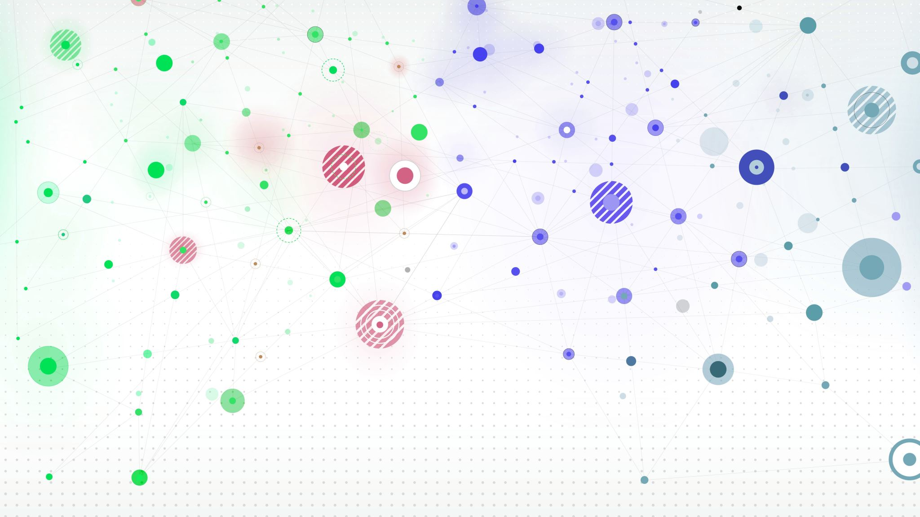
Simulations for Waves
By Azal Amer

Slide 2
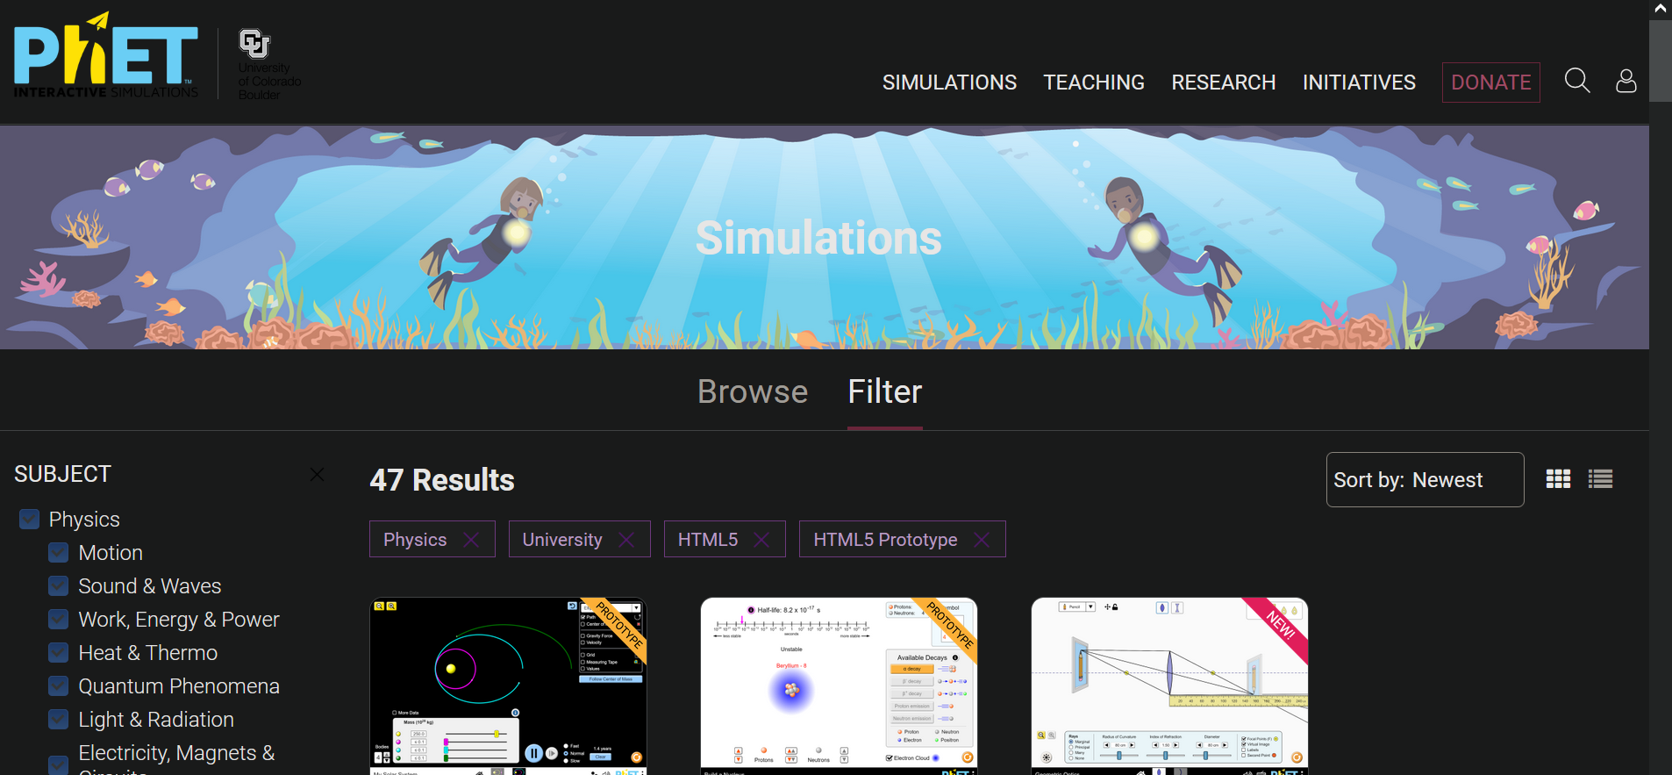
Objective

Slide 3
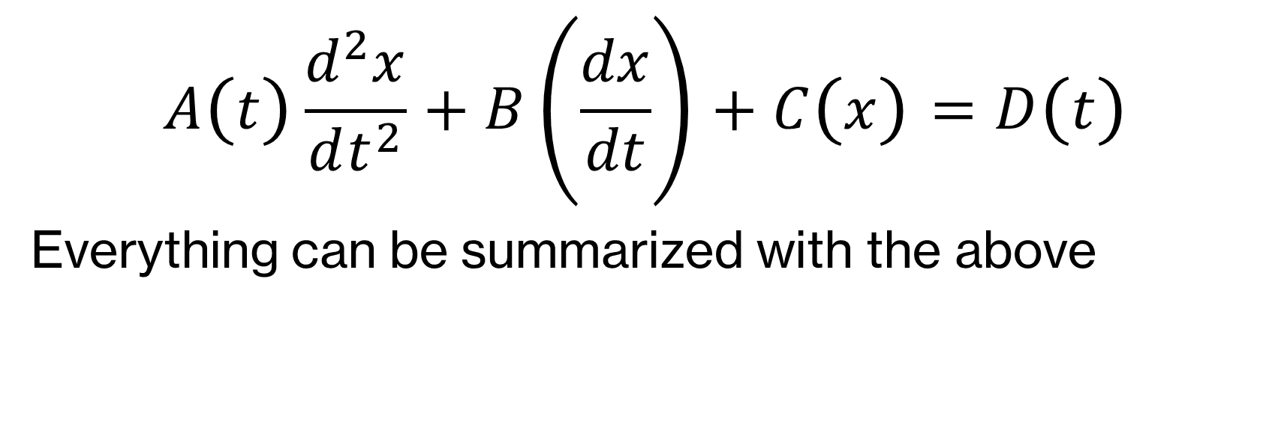
What I’ve done so far :
$$A\left(t\right)\frac{d^{2}x}{dt^{2}}+B\left(\frac{dx}{dt}\right)+C\left(x\right)=D\left(t\right)$$
Everything can be summarized with the above

Slide 4
Process
Notes
Completed 10 Diff Eq Lectures (4 to go)
3 Physics 3 Lectures
Go through each lecture with notes, along with annotating accompanying reading
Meeting with Mr. Haskins with questions
Assignments
Complete 2 questions from each problem set, typically first and last.
Gives good representation of the style of problems both simple and difficult

Slide 5
Computation:
Effective Simulation
RK4 vs Eulers method
Indirect vs Direct
Why the constraints?
The setup

Slide 6
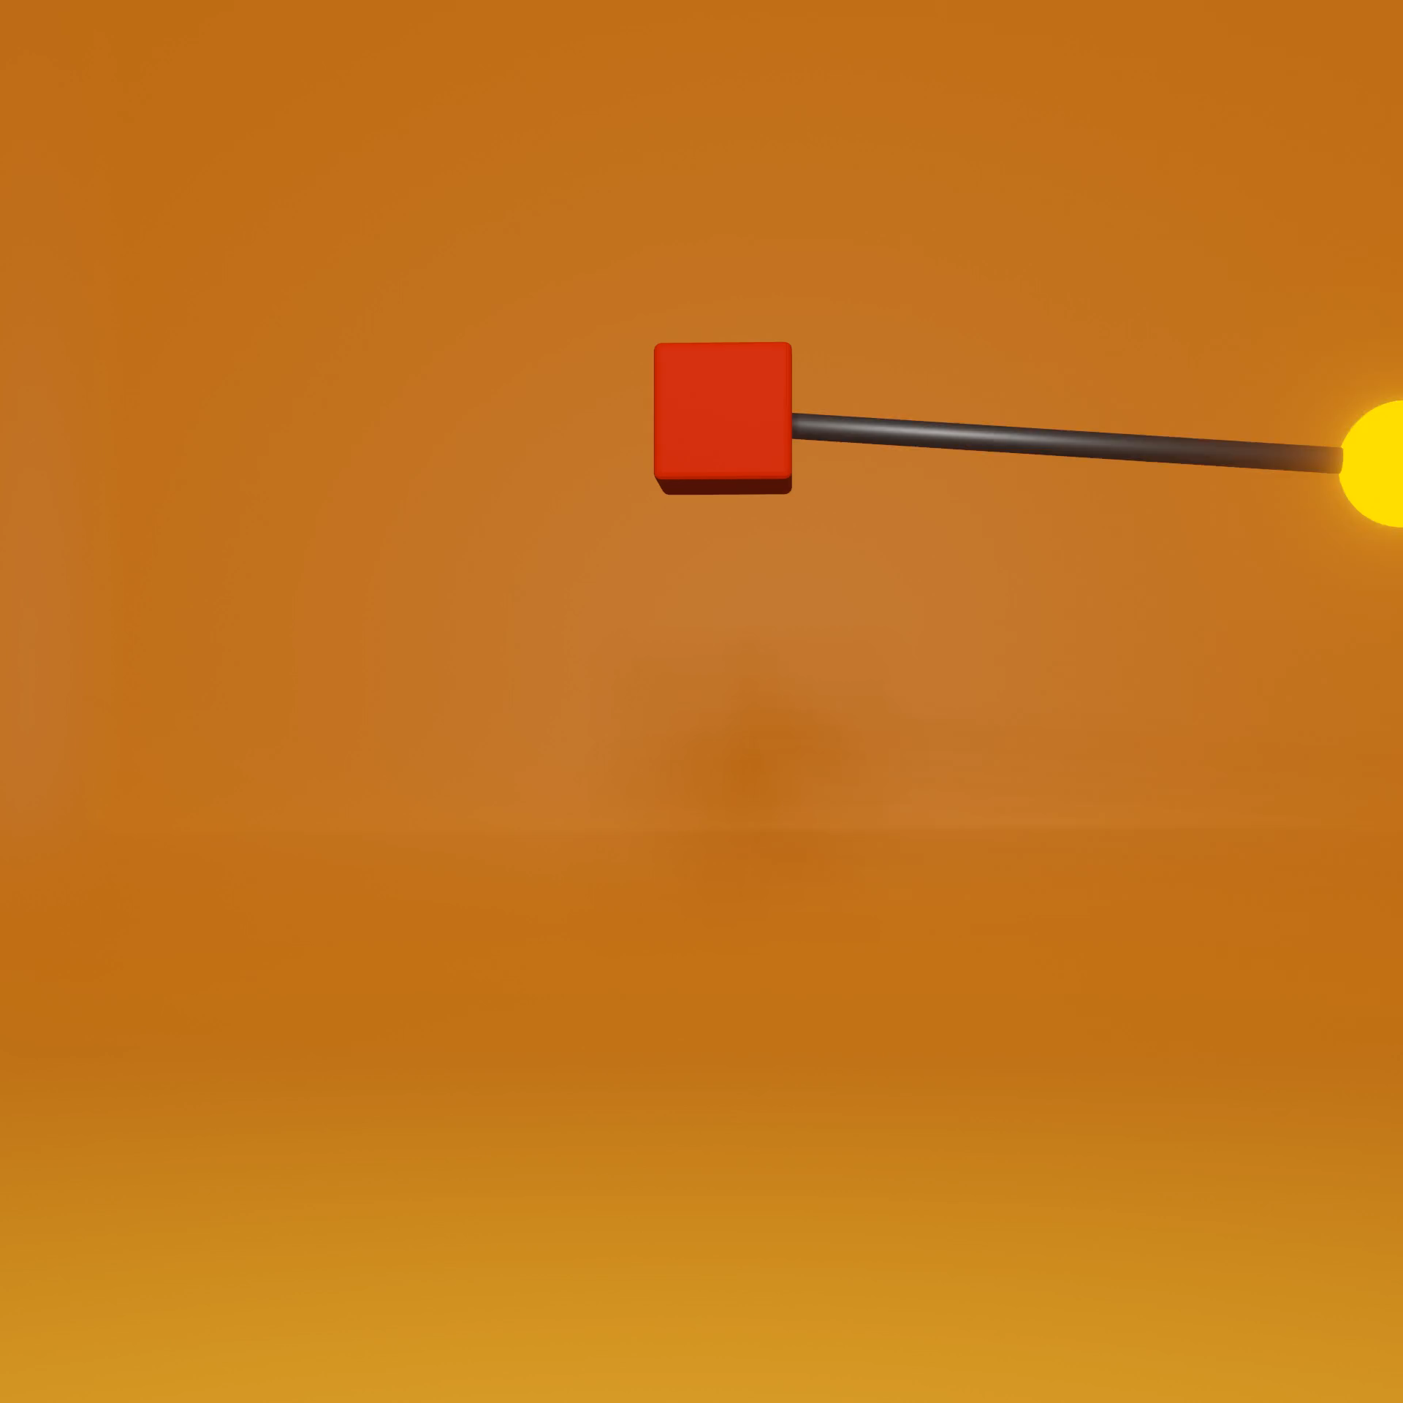
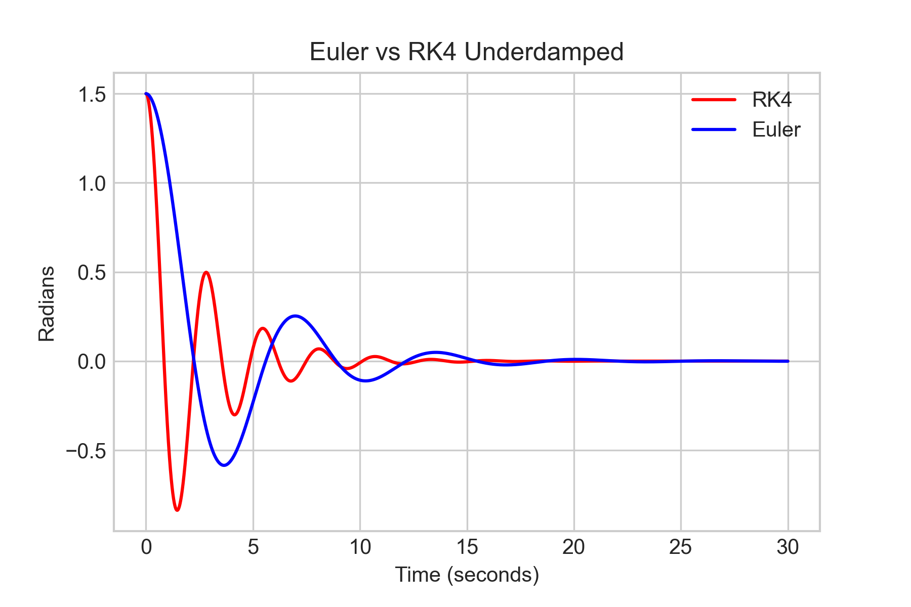
Underdampened

Slide 7

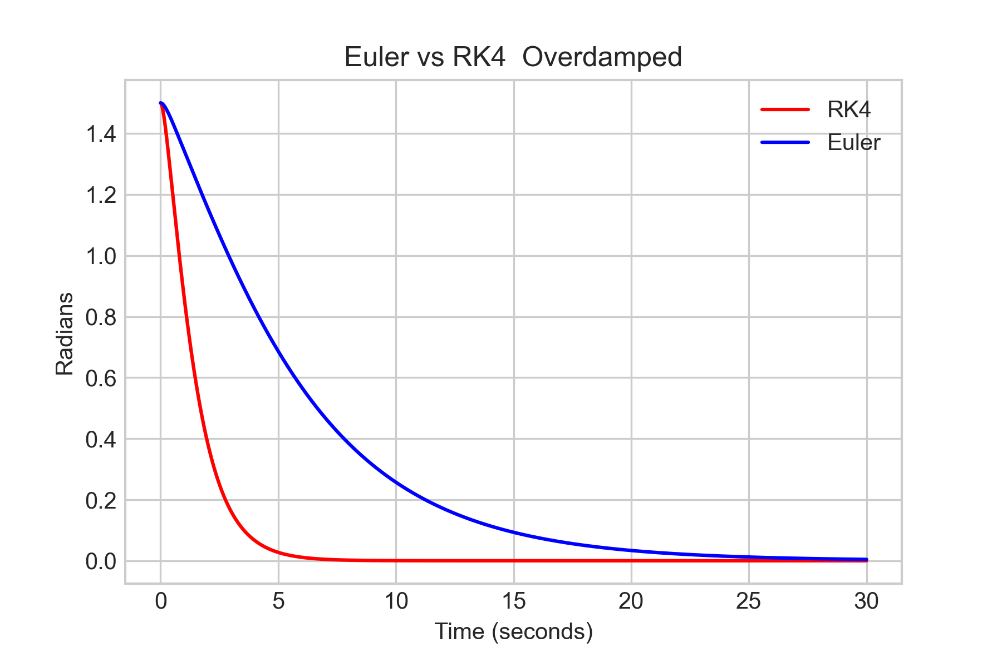
Overdamped

Slide 8

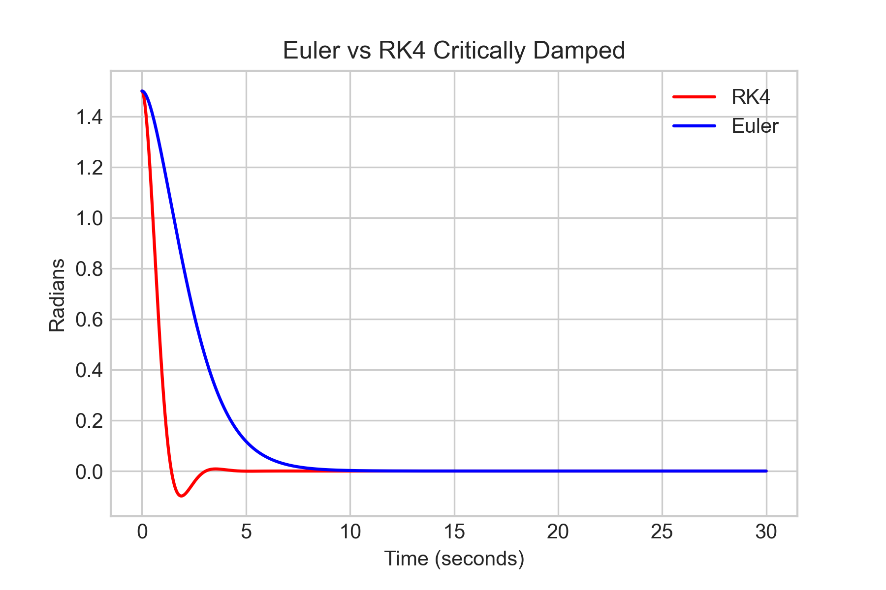
Critically Damped

Slide 9
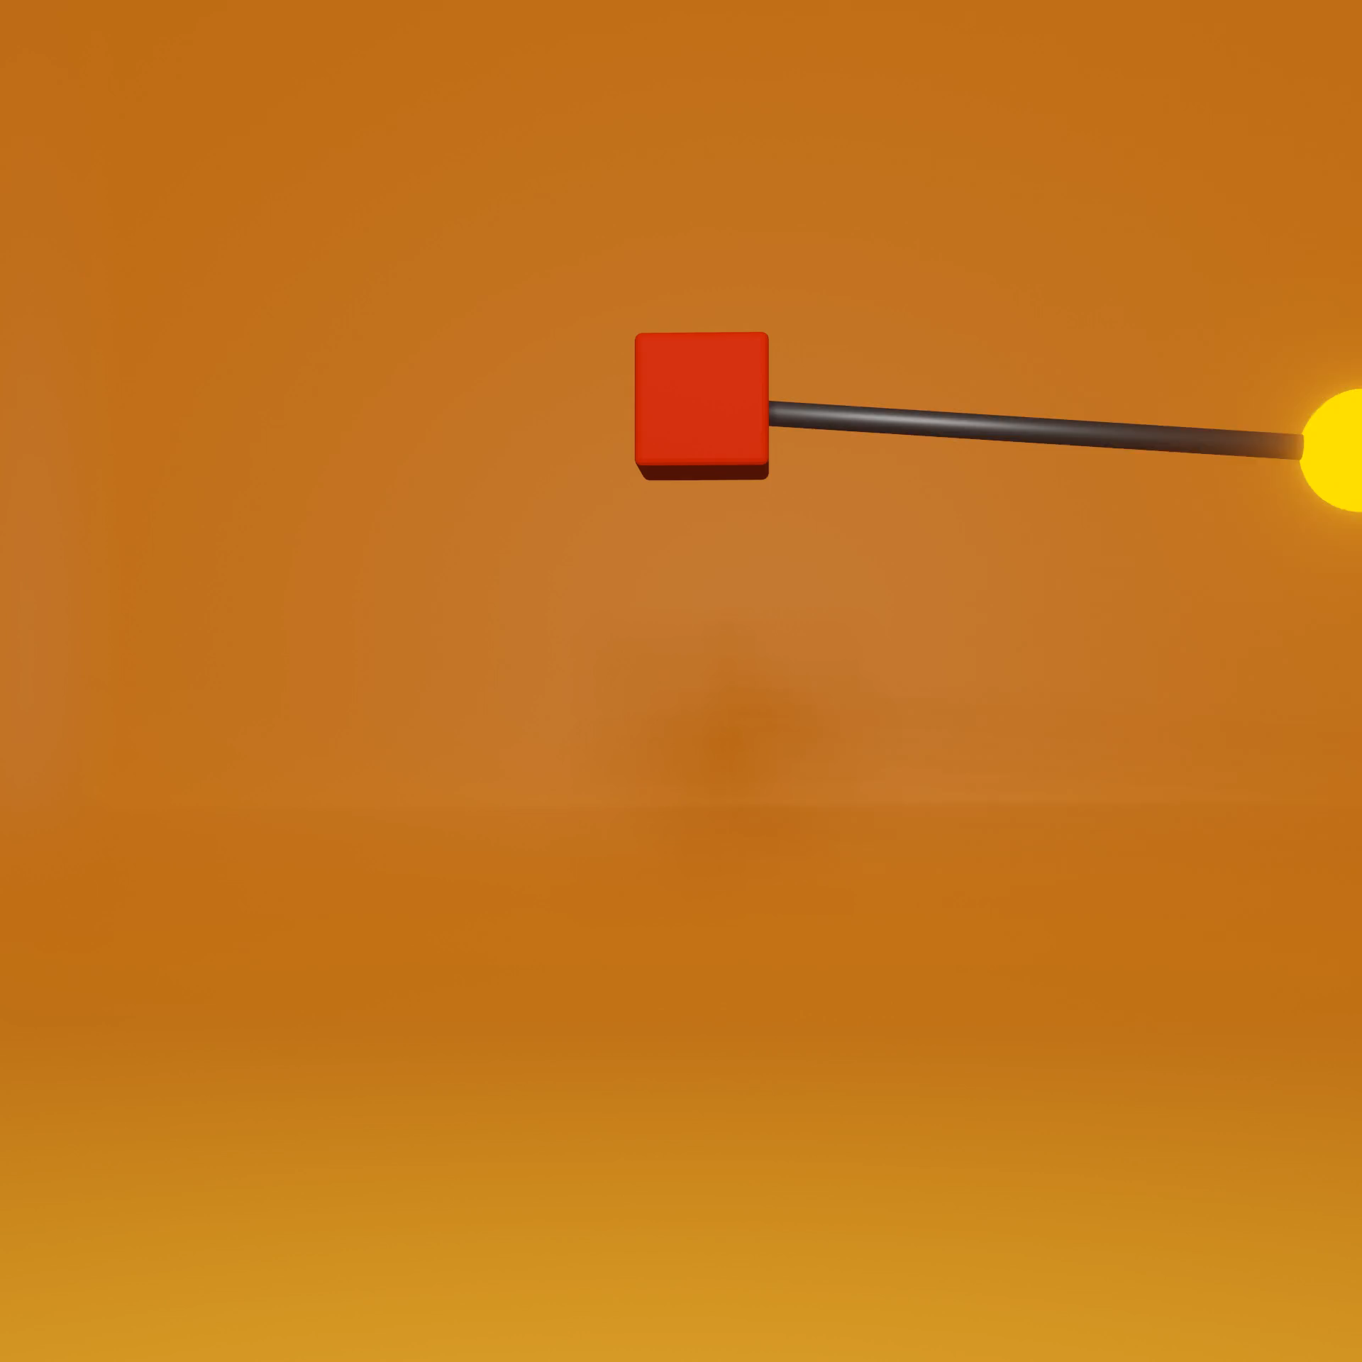
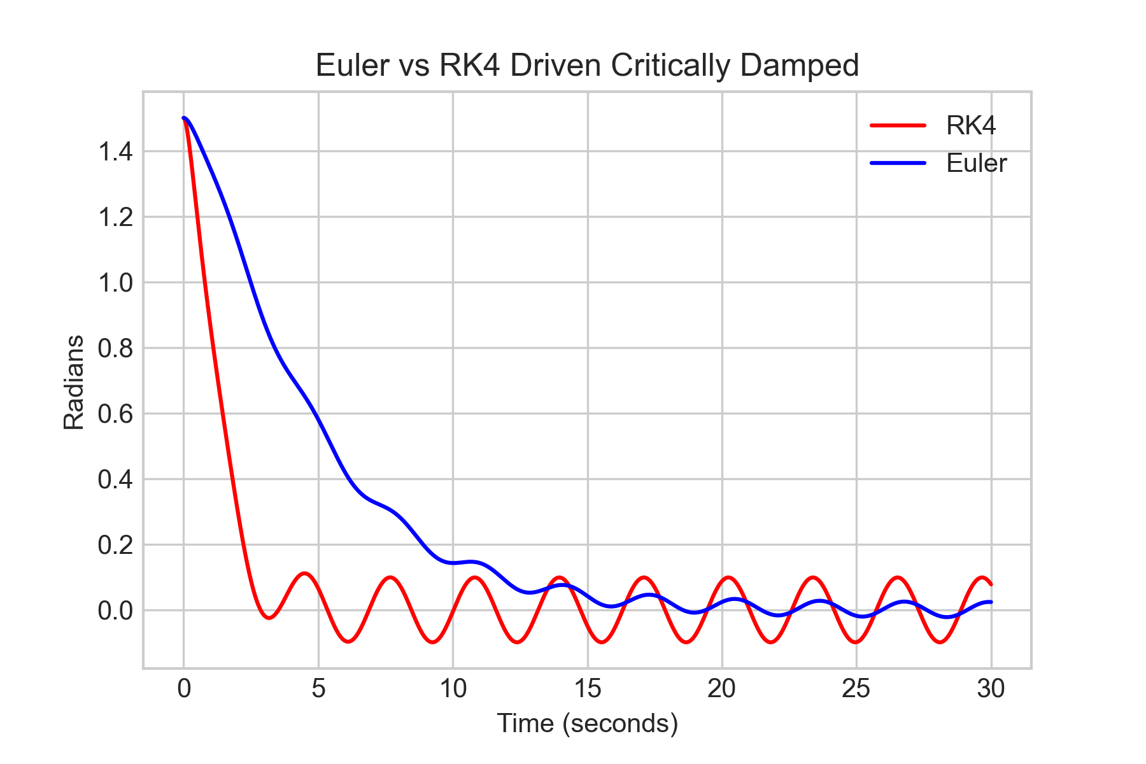
Resonance driving with Critical Dampening

Slide 10
Discovery- Techniques of learning
A single style of teaching would not be ideal if teaching a course combining differential equations and Physics 3
Physics 3 lectures teach a very brief and non-intuitive version of DiffEq, requiring me to spend a large mass of time on it
Aesthetics should not go unnoticed, these can’t just look like drawings

Slide 11
Next Steps
What Continues?
Lectures:
Low progress on Physics Course itself
Meetings
What Changes
Pivoting off of DiffEq
Moving off of problem sets in favor of mini-simulations for practice
Dedicated work times on efficient browser computation methods
Implement a diffeq solving algorithm for solvable systems

